Slide 1
Synklinx
The World’s First Smart Necklace

Slide 2
Agenda
Project Description
Design Specifications
System Architecture
Prototype Design and Fabrication
Application Prototype
Testing Procedure
Results and Validation
Broader Impacts
Ethical Considerations
Conclusion

Slide 3
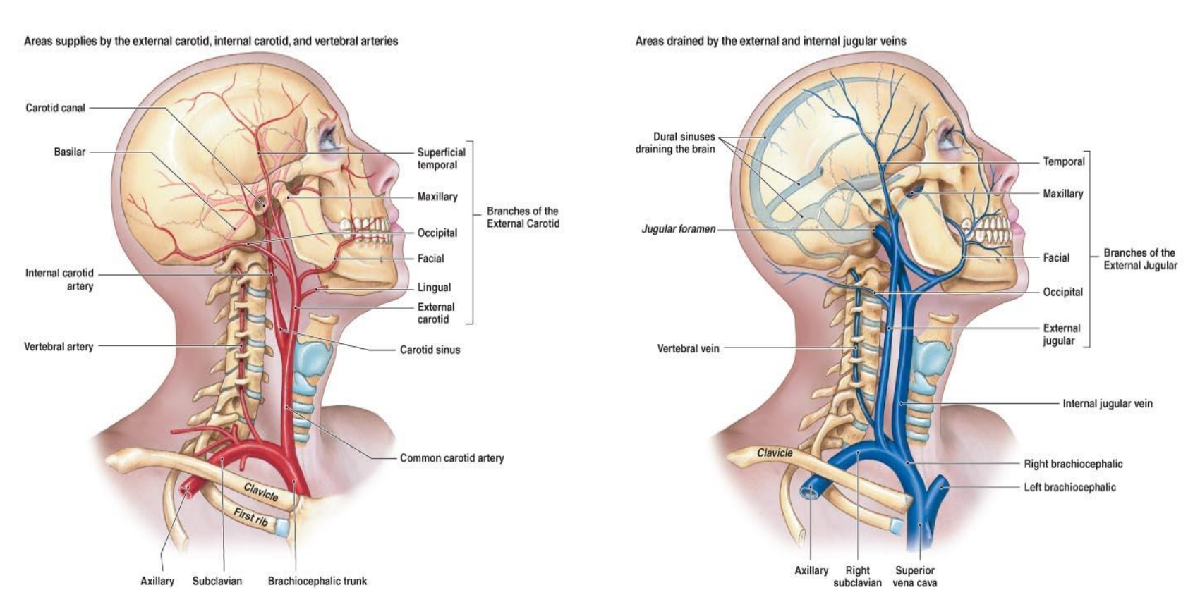
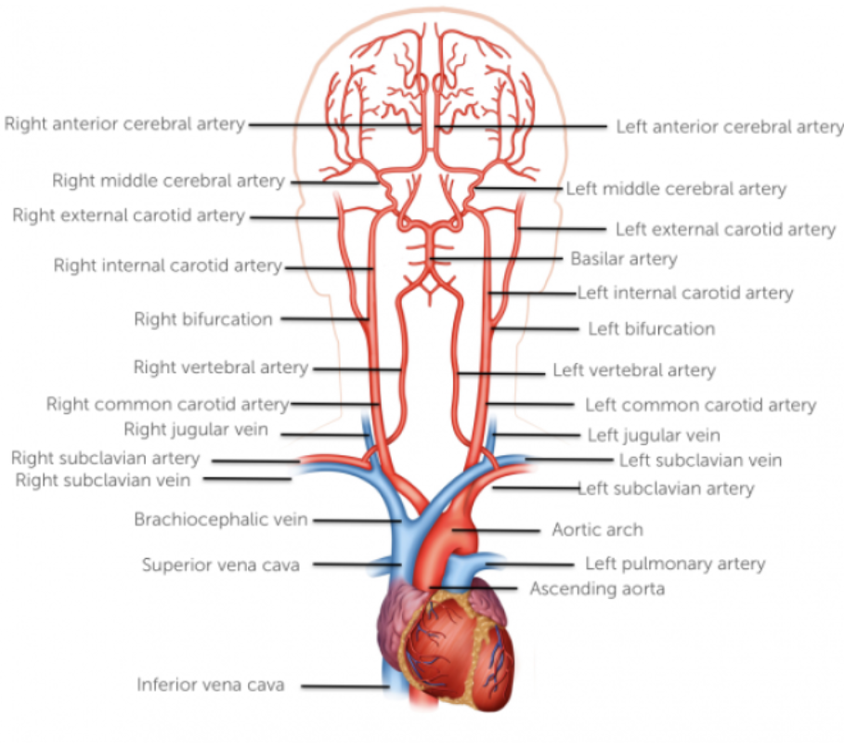
Project Description
SynkLinx - the first health-monitoring smart necklace, is designed to track heart rate, blood oxygen saturation, and core temperature while maintaining the aesthetics and comfort of everyday jewelry.
The device leverages the anatomy of the neck—specifically proximity to the carotid artery, jugular vein, and surrounding thermoregulation pathways—to obtain accurate vital-sign readings with minimal user discomfort.
Data from MAX30102 and MCP9808 sensors is streamed via BLE to a custom iOS application, allowing real-time monitoring, health alerts, and connectivity notifications within a streamlined mobile interface.
SynkLinx targets users who need health tracking without wearing wrist-based devices, offering a safer option for athletes, individuals with medical concerns, or users who prefer traditional wrist jewelry.
Blood vessels in head//neck region (side view)
Blood vessels in head/neck region (front view)

Slide 4
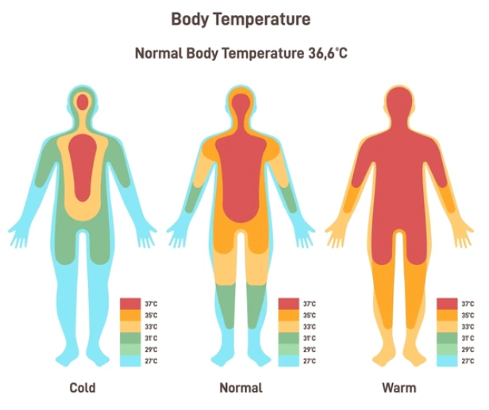
Project Description
Data is transmitted via Bluetooth to a custom mobile app, where users can view real-time vitals, receive connectivity and health alerts, and manage device functions—all without relying heavily on their phone or risking wrist device damage.
SynkLinx fills a major market gap in wearable technology, offering a stylish, safe, and versatile option priced at $199.99, with future custom bands and features planned to enhance personalization and broader consumer appeal.
Core Thermoregulation Chart

Slide 5
Design Specifications
Device Size & Weight: The SynkLinx prototype fits within a compact 1 × 5 inch footprint, with total thickness under 0.5 inches and a target weight of 15–25 grams, including sensors, battery, wiring, and housing.
Power Requirements: Powered by a 3.7 V 500 mAh Li-ion battery, supplying sufficient energy for the ESP32-C3, MAX30102, and MCP9808 sensors, with run time dependent on Bluetooth usage and continuous sampling.
Sensor Communication: Both the MAX30102 (HR/SpO₂) and MCP9808 (temperature) communicate over I²C, each with unique device addresses on shared SDA/SCL lines to prevent bus conflicts.
Connectivity & Data Output: The ESP32-C3 provides Bluetooth Low Energy (BLE) communication, transmitting heart rate, oxygen saturation, and body temperature to an iOS application in real time.
Material & Wearability Requirements: The necklace band uses a contouring, moisture-resistant woven material to maintain sensor contact with the skin, prevent movement, and ensure accurate measurements.
Safety Features: Includes a breakaway clasp for emergency release and uses non-irritant materials to ensure safe prolonged skin contact.
Accuracy Targets: All vital-sign readings aim for ≤5% margin of error, aligning with medically accepted ranges from the American Heart Association and Mayo Clinic.

Slide 6
Design Specifications
Device Specifications Table
Component | Function(s) | Data Retrieval/Sampling | Dimensions(mm) | Weight | Sensor Range/Accuracy
Battery: 3.7 Volt LiPo 500mAh | Powers wearable smart necklace | N/A | 52 x 20 x 5 (L x W x T) | 10g | Battery life range up to 4 hours.
XIAO ESP32-C3 | MCU: BLE, Wi-Fi, sensor comm | I2C up to 400 kHz | 21 X 17.5 x 3.5 | ~3g | N/A
MAX30102 Pulse Oximeter / HR Sensor | Heart Rate & SpO₂ | Configurable up to 3200 samples/sec | ~12 x 11 x 3 | ~1g | HR: 30–250 BPM SpO₂: 0–100% Accuracy: HR ±1–2 BPM, SpO₂ ±2–3%
MCP9808 Temperature Sensor | Body/ Ambient Temperature | 0.25 °C resolution, ~250 ms conversion | 4.5 x 4.5 x 1.5 | ~1g | -40 °C to +125 °C Accuracy ±0.5 °C
Wiring/SynkLinx Housing | Interconnect and wearable housing | N/A | 558 x 25 x 10 | ~20g | N/A

Slide 7
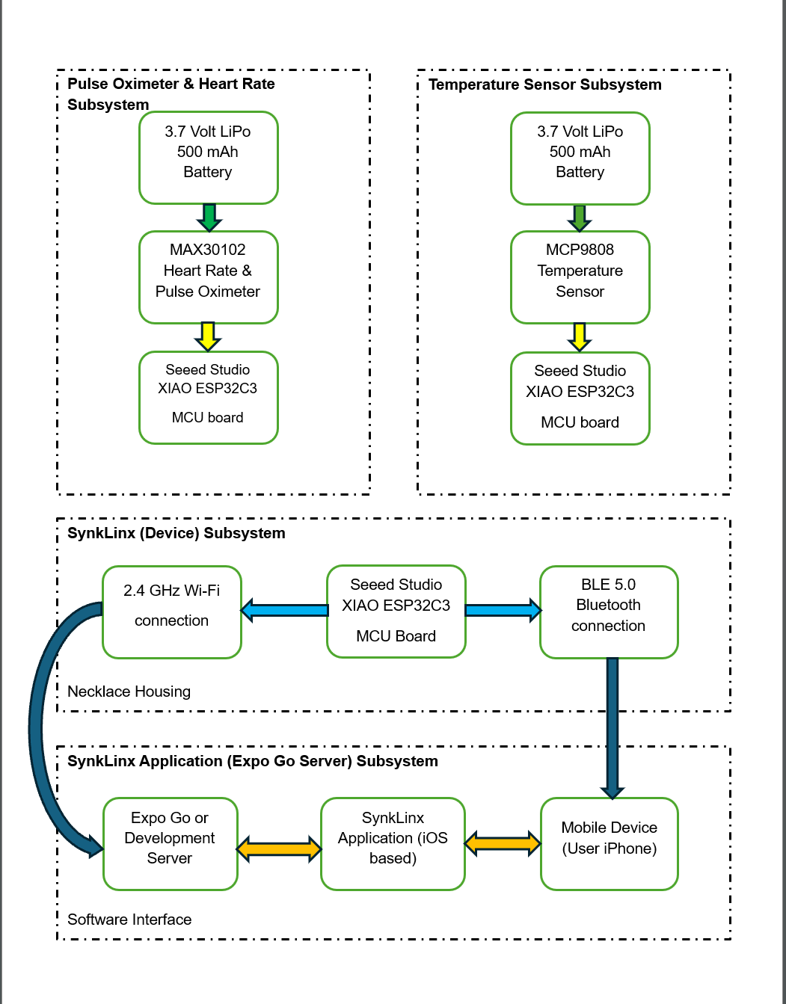
Design Solution
Product Architecture
System architecture consists of four core blocks:
Pulse oximeter subsystem
Temperature subsystem
ESP32-based device subsystem
BLE-enabled mobile application.
Sensors collect physiological data and send it to the microcontroller, which then transmits processed values to the iOS app in real time.
Block diagram illustrates how data flows from sensors → microcontroller → BLE service → mobile interface.
SynkLinx Subsystems Diagram

Slide 8
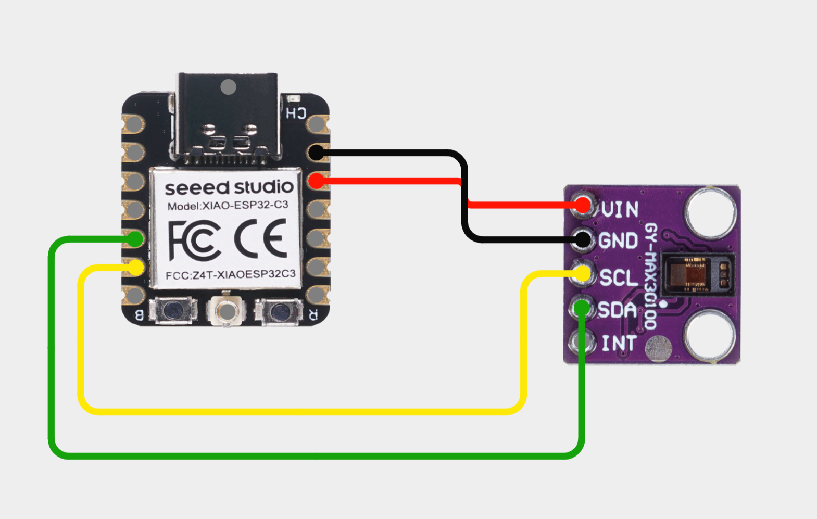
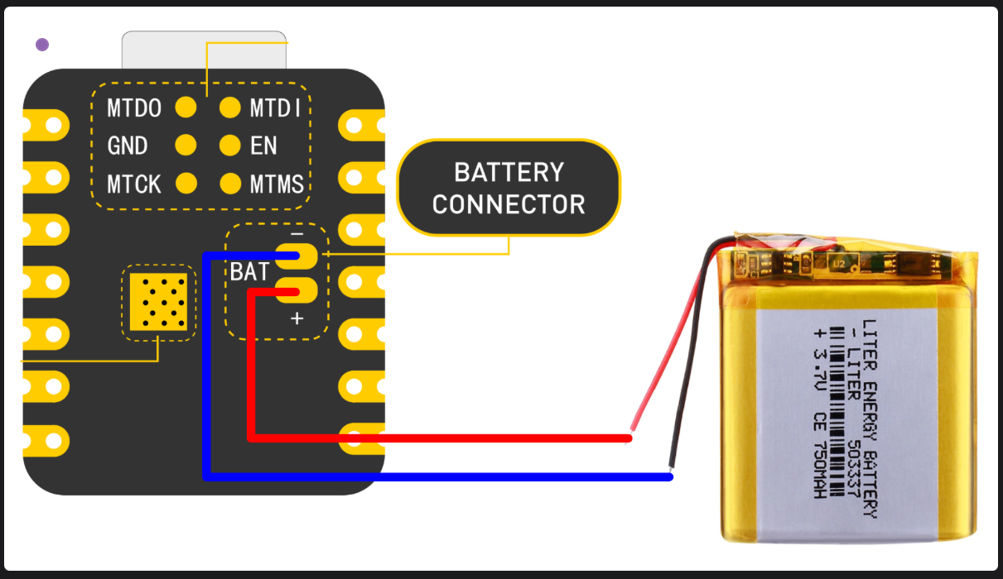
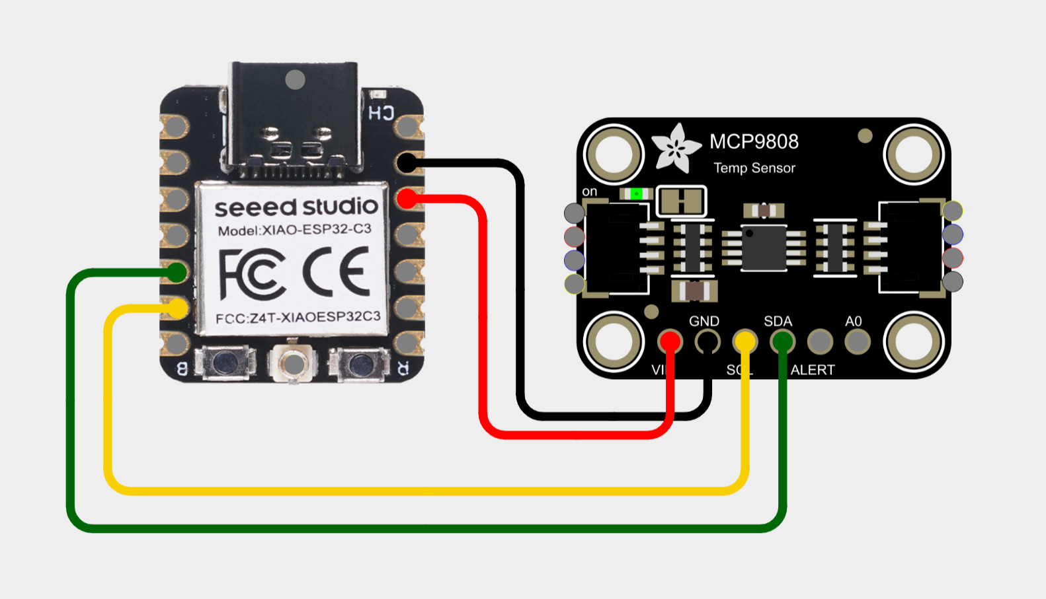
Design Solution
Hardware Subsystems/Wiring
Pulse Oximeter & Heart Rate Subsystem
Uses the MAX30102, chosen for its high sensitivity LED/photodiode array capable of measuring HR and SpO₂.
Wired via I²C (SDA/SCL), sharing the bus with the temperature sensor but maintaining its own address.
Requires stable skin contact and minimal ambient light interference for accurate PPG (photoplethysmography) measurements.
Temperature Sensor Subsystem
Uses the MCP9808, a high-accuracy digital temperature sensor capable of ±0.25°C precision.
Also communicates via I²C and is mounted near major blood vessels in the neck to maximize thermal accuracy.
Identical wiring topology to MAX30102 for easy integration and modularity.
Lithium-Ion Battery Placement
The ESP32-C3 includes dedicated + / – battery terminals for direct Li-ion connection.
A 3.7 V 500 mAh cell provides the necessary operating time while meeting size and weight constraints.
Battery placement is optimized behind the neck to balance weight and maintain comfort.
Pulse Oximeter & Heart Rate Subsystem
Lithium-Ion Battery Placement
Temperature Sensor Subsystem

Slide 9
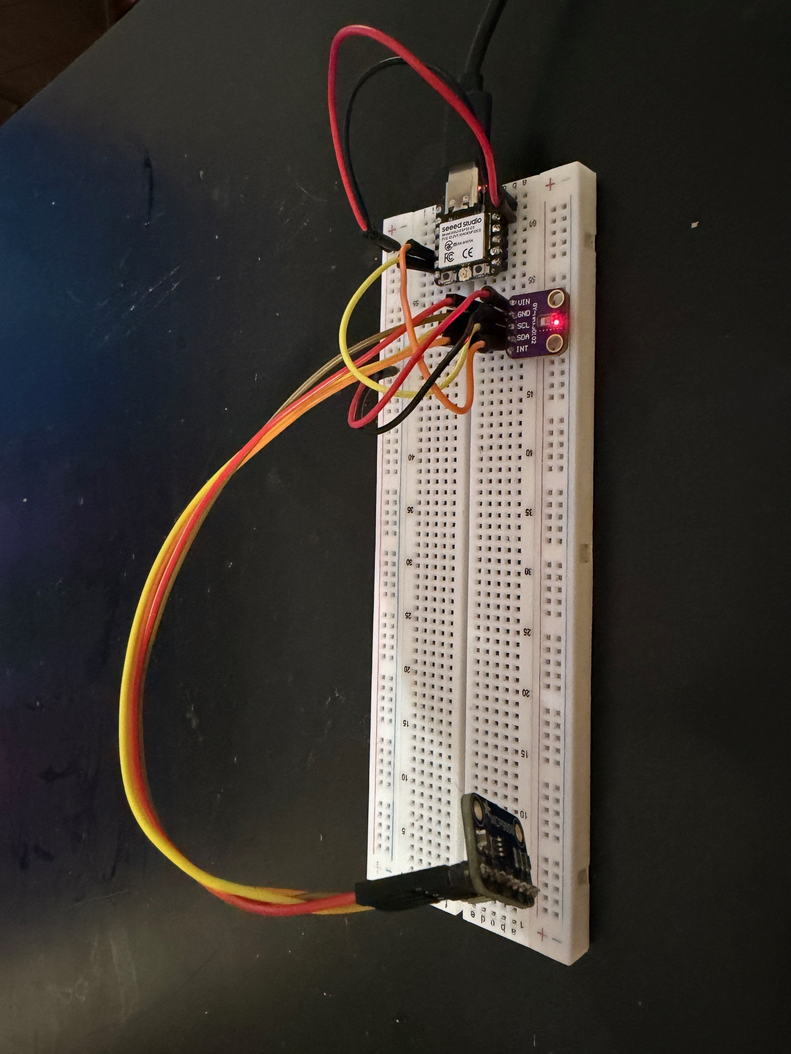
Prototype Design and Fabrication
Initial prototype assembled on a breadboard, using USB-C power during early development for stable testing and rapid troubleshooting.
MAX30102 and MCP9808 modules were wired to the ESP32-C3 using soldered jumper wires, ensuring reliable I²C communication during physical testing.
Early verification performed using Arduino example code, validating sensor initialization, wiring continuity, and data output via Serial Monitor.
React Native app connected through Expo Go, allowing real-time BLE testing while refining UI screens, animations, and BLE connection behaviors
Initial Prototype (Breadboard)

Slide 10
Application Prototype
App.jsx – Hub file for combining Homepage and Dashboard screens
Homepage.jsx – First screen displayed when tapping on the app. It features a start button that transitions the user to the DeviceModal screen
DeviceModal.jsx – The file where device scanning and connectivity takes place
Dashboard.jsx – File for the data metrics. Imports the needed files and is responsible for handling the animations and the visuals
dataAlert.jsx – Returns notifications from the three vitals for connectivity issues, warnings, and danger if vitals deviate from medically approved statistics
PulseIndicator.jsx – Responsible for pulse animation behind the heart rate, oxygen saturation, and body temperature
useBLE.jsx – File that links the service and characteristic data from the physical device to the mobile application and streams real time data on the app
BLEProvider.jsx – File that allows Bluetooth service to be used across multiple screens without overlap in the application interface
Firmware.cpp – Contains the firmware from Arduino IDE, uploaded into SynkLinx device to allow connection and data streaming

Slide 11
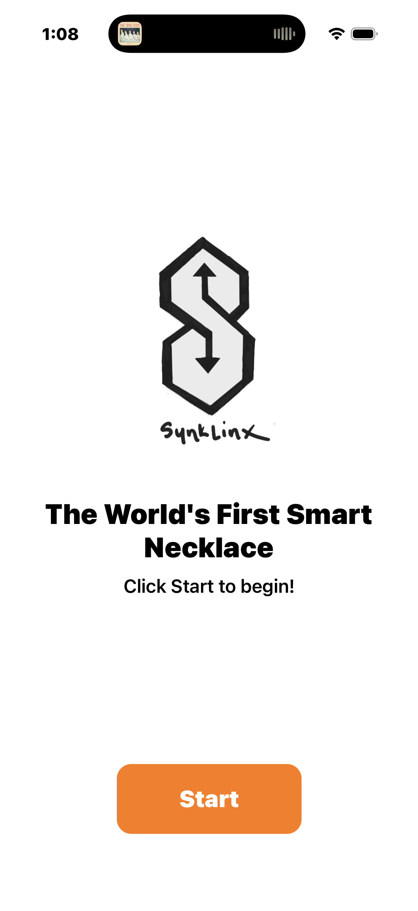
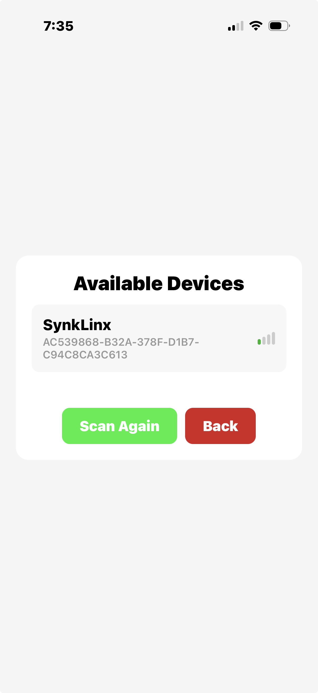
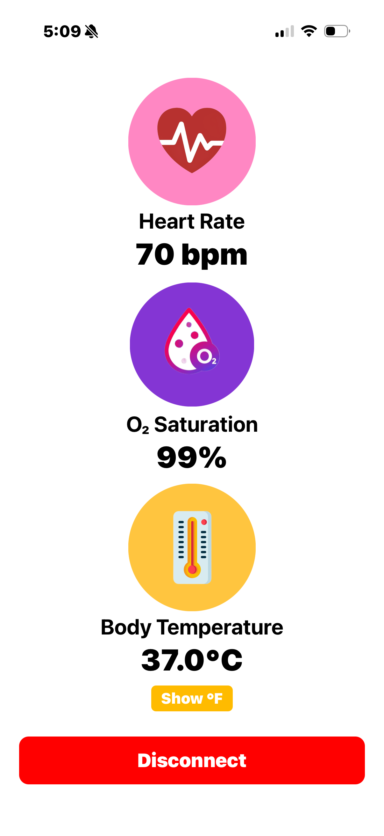
Screens for (SynkLinx) Application Interface
HomePage.jsx
DeviceModal.jsx
Dashboard.jsx

Slide 12
Testing Procedure
Information from reputable and certified health institutions like The American Heart Association and The Mayo Clinic were used to determine the warning and danger alerts for the three vital signs (Heartrate, SpO2, temperature)
During testing and validation, I outlined a simple, five step process of how SynkLinx prototype works in daily activity:
Check that SynkLinx device has sufficient charge, then power up device
Attach and adjust prototype to comfortable fit around test subject’s neck
Open iPhone and select SynkLinx iOS app, press start, then scan for available devices (SynkLinx)
Once connected, give the device 5-10 seconds to process subjects heart rate, oxygen saturation, and body temperature
While monitoring the app, results show up in real-time, along with warnings and danger alerts regarding vitals
The ESP32-C3 main board and two MAX30102 and MCP9808 sensors were soldered together using jumper wires and fastened around the test subject’s neck. Data was collected and streamed to the iOS app. I recorded results of each metric in the serial monitor window of VS code and compared the SynkLinx data to readings from an existing pulse oximeter and non-contact thermometer

Slide 13
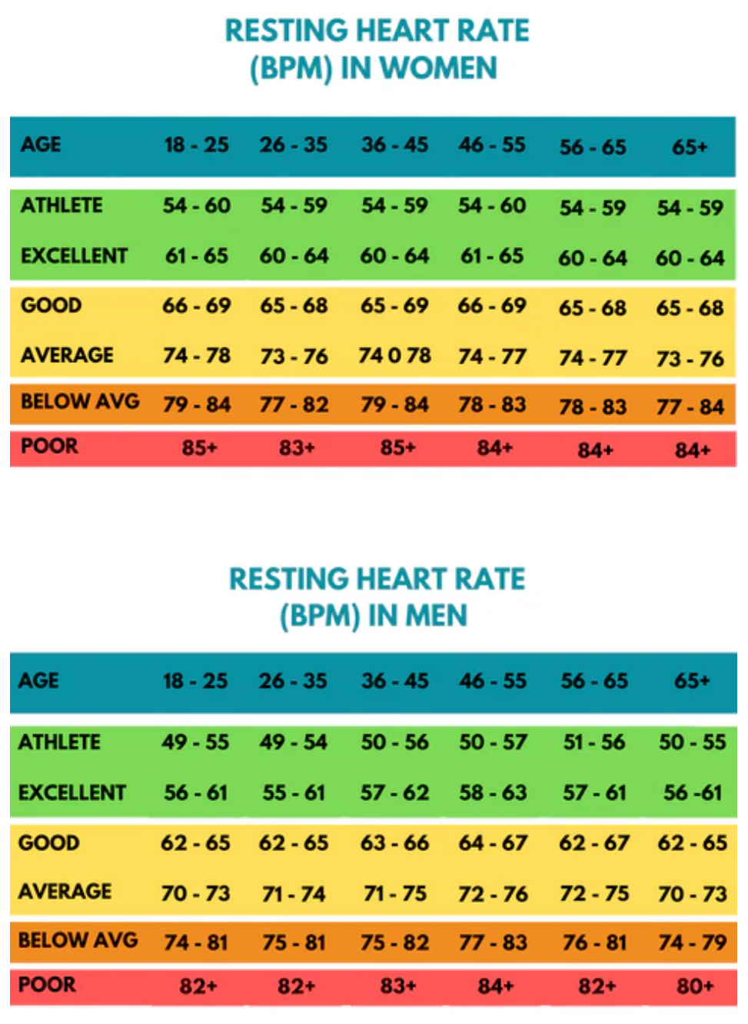
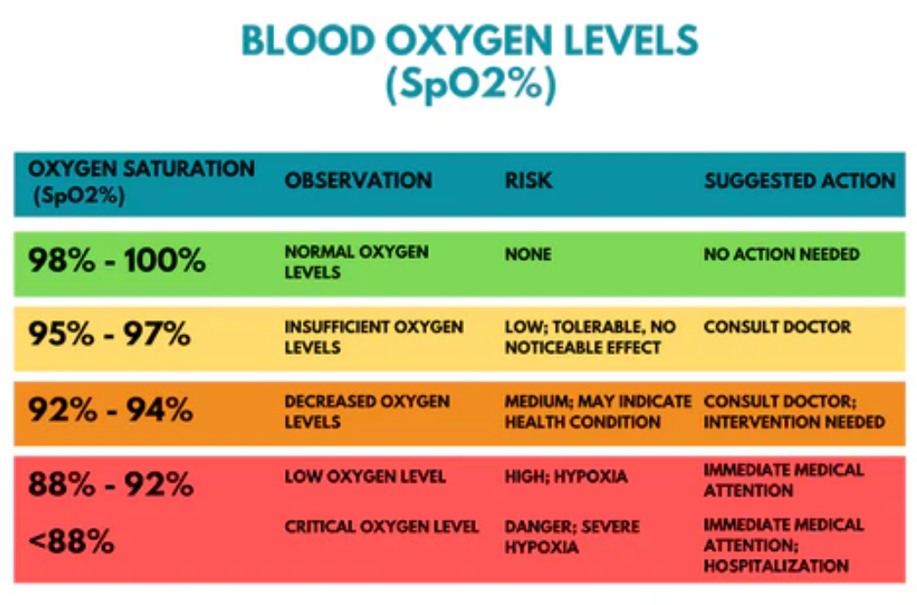
Blood Oxygen Level Chart
Resting Heart Rate Chart

Slide 14
Results and Validation
The testing results from the charts above was based on extracting the three desired health parameters over a 30 second interval.
After obtaining a value for each second, the results from the two measuring devices were compared, using the percent error formula.
Using the mean of the 30 values, a cumulative percent error was calculated for each vital sign (results table shown on next slide)

Slide 15
Results and Validation
 | Experimental | Actual | Percent Error
Heart Rate (bpm) | 57.67 | 61.40 | 6.07%
Core Temperature F(C) | 99.32(37.40) | 97.22(36.23) | 2.16%
Blood Oxygen (%) | 96.20 | 97.22 | 1.05%

Slide 16
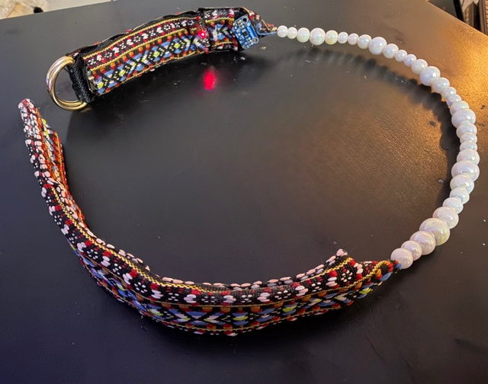
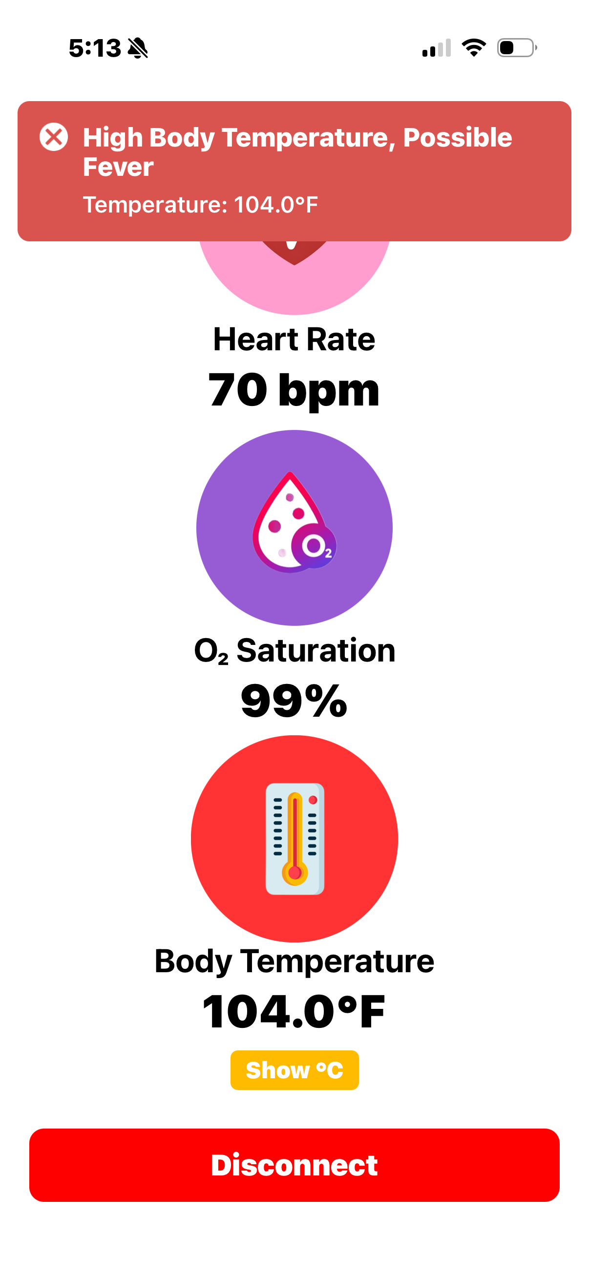
Broader Impacts
Ethical and Professional Considerations
Public Health | Aligning with the Hippocratic Oath and the National Society of Professional Engineers (NSPE) Code of Ethics, the user’s health and well-being will be protected.
Safety/Wellness | The device shall be tested on the subject in normal conditions, using safe practices and assistance on standby.
Global Impact | If prototype goals are accomplished, device production will span worldwide.
Cultural Impact | The product will create a new sub-category of wearables, featuring customizable necklace hardware, for consumer personalization.
Social factors | The device will monitor important daily health metrics in real time and notify users to seek medical attention if necessary.
Environmental factors | Device uses minimal amounts of plastics. Raw materials are non-toxic and do not contribute to hazardous waste.
Economic factors | Target budget is based on market competition. For a new device, seller discretion and demand determines price.
Considering that this device is the first of its kind, I hope to achieve a high level of interest from tech companies to launch SynkLinx into production
I believe the impact can be made on a global scale like many of its wearable counterparts have done already.

Slide 17
Ethical Considerations
User safety – device shall be tested on subjects in normal conditions, using safe practices and assistance on standby to ensure completely safe usage for the consumer
Data privacy – user data will not be sold or exchanged; all data will be securely transmitted and encrypted
NSPE alignment – The Code of Ethics was and will continue to be followed during the projects development
Environmental factors – Device uses minimal amounts of plastics. Raw materials are non-toxic and do not contribute to hazardous waste

Slide 18
Conclusion
The SynkLinx device prototype was successful in collecting heart rate, blood oxygen percentage, and core temperatures through designated sensors, then transmitting the data to the iOS app for viewing
I failed to get below my percent error goal of 5%, but it was only in the heart rate metric. There is room for improvement
The price point for the SynkLinx prototype ($149.99) is of reasonable value, especially for a product that is the first of its kind
Looking ahead, I believe smaller boards and quality materials will be manufactured to accommodate smart necklaces. This concept has yet to be explored in depth, but I hope that my vision can garner the attention of those in the technological field, and many will consider the viability of SynkLinx in real world applicability

Slide 19
THANK YOU

